Slide 1


IMDB Movie Review Sentiment Analysis
TEAM MEMBERS-GROUP7
vamshi krishna perabathula
Manaswini patel thogaru
Sai Niharika Hari
Nikhil Chandra Chinthapanti
Nischala Reddy Satish Kumar
Uma Shankar Rao Chatla

Slide 2
TABLE OF CONTENTS
01
Data Exploration
04
results
02
Methodology
05
Data Visualization
03
ML model training and building
06
conclusion

Slide 3
DATASET
kaggle dataset-https://www.kaggle.com/datasets/lakshmi25npathi/imdb-dataset-of-50k-movie-reviews?resource=download
PROBLEM STATEMENT
Our project is to classify the sentiment expressed in a piece of text for movie reviews.
To accurately predict whether a given movie review is positive or negative.

Slide 4
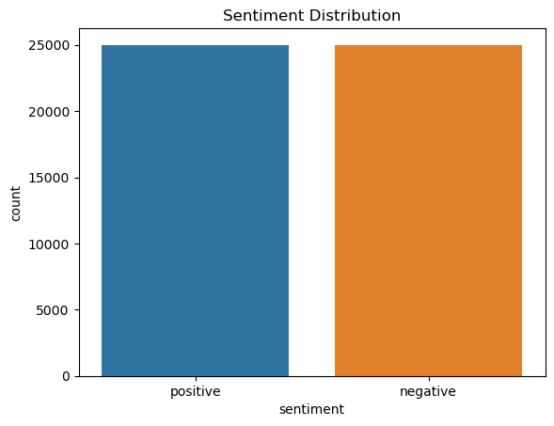
DATA EXPLORATION
Class Distribution
The code is used to assess the balance of sentiment classes in a dataset, which is critical for training machine learning models for sentiment analysis.
Balanced datasets help prevent models from developing a bias toward a more frequently occurring class.
The visualization aids in quickly verifying the balance and understanding the dataset's structure before proceeding with further analysis or model training.

Slide 5
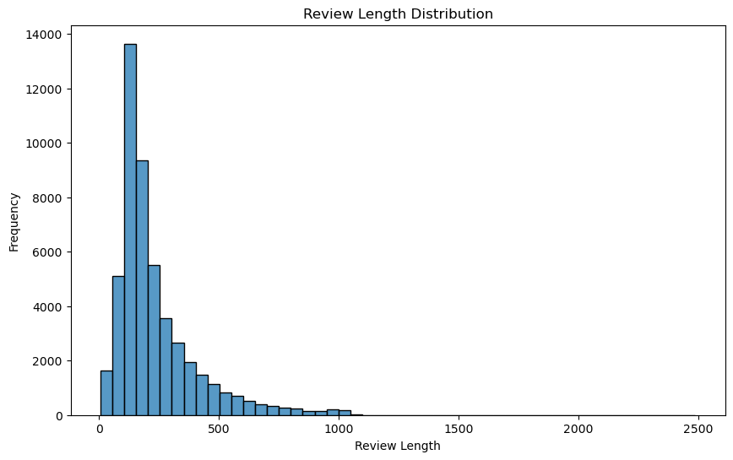
REVIEWING LENGTH DISTRIBUTION
It visualizes the distribution of review lengths across a dataset of textual reviews.
By plotting this distribution, it can gain insights into common review lengths, identify any outliers, and understand how verbose the reviews are.
Such analysis is essential in preparing data for machine learning models in natural language processing (NLP), as the length of the input texts can affect both the performance and the computational requirements of the models.

Slide 6
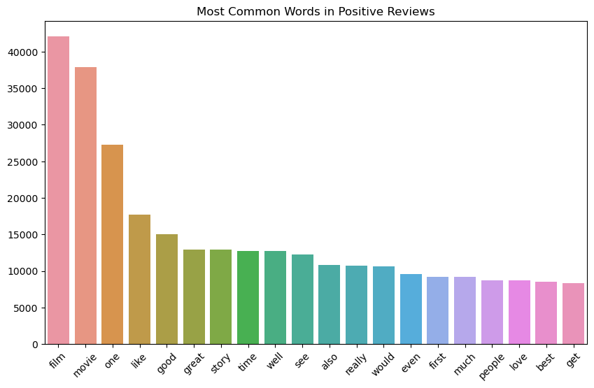
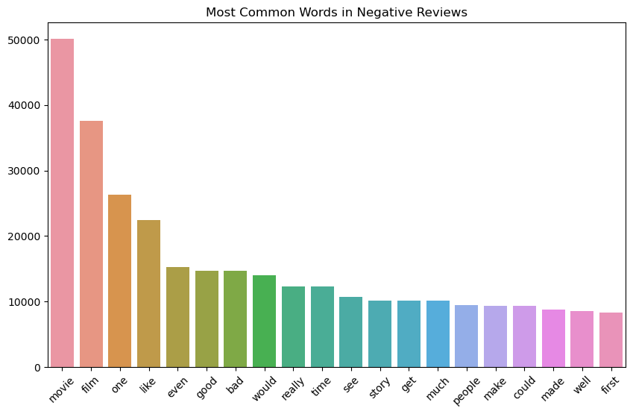
Most Frequent Words in Positive and Negative Reviews
By comparing the most common words in positive and negative reviews, one can gain insights into the language and expressions typically associated with each sentiment.
This analysis could help in refining algorithms for better sentiment prediction by understanding which words are most influential in defining sentiment.

Slide 7



METHODOLGY
Data Collection
Data Preprocessing
Model Building
Model Deployment

Slide 8
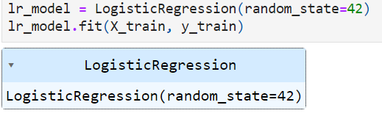
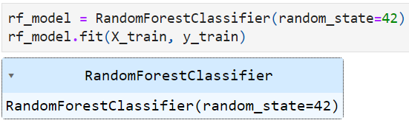
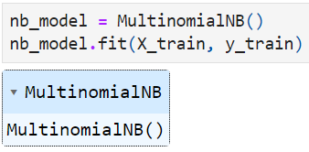
MODEL TRAINING AND BUILDING
As the methodology suggests, we first imported and cleaned the data.
We then split the data into training and testing data and trained the model to test it out.
Logistic Regression,Naive Bayes and Random Forest Classifier were used for this project.

Slide 9
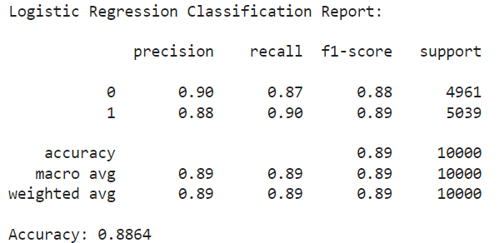
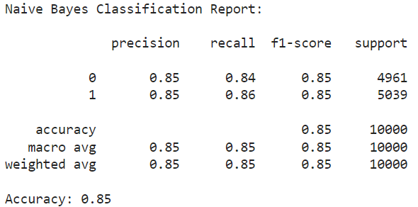
METHOD 1
Here we are going to use TF-IDF and logistic regression,Naive Bayes and Random forest methods for model analysis
Logistic Regression-Accuracy:88.6%
Naive Bayes-Accuracy:85%

Slide 10
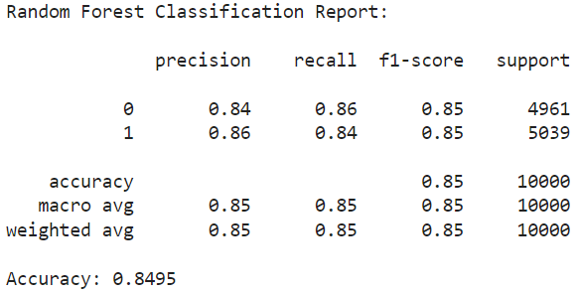
Analysis of method -1
Model Comparison:Comparing the results of different models to identify which one performs the best in terms of accuracy and F1-score.
Improve Text Preprocessing:Experimenting with more advanced NLP techniques such as stemming, lemmatization, or using n-grams in the vectorization step.
Random Forest-Accuracy:84.9%
Hyperparameter Tuning:For the best-performing model, conducting hyperparameter tuning using grid search or random search to optimize its performance.
Use Different Vectorization Techniques:using Word2Vec or GloVe embeddings instead of TF-IDF to see if they improve model performance.
Expand the Dataset:Sometimes models perform better when trained on more data. Consider augmenting the dataset or using additional data sources.

Slide 11
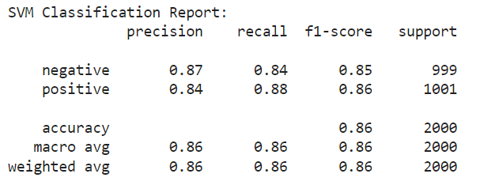
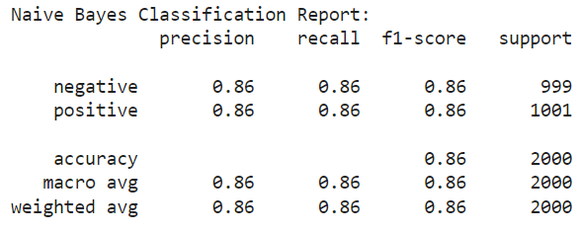
METHOD-2
Here we are going to use SVM and Naive Bayes methods for model analysis
In this analysis, both models have same accuracy 86%

Slide 12
Analysis of method 2
Based on the results we got can improve the results as mentioned below mainly we should focus on
Tuning model parameters using techniques like grid search.
Using more complex models or ensembles.
Increasing the dataset size or using different features, like bi-grams or tri-grams in TF-IDF.
Implementing more advanced text preprocessing techniques.
Feature Engineering: More sophisticated text features like sentiment scores or POS tagging could enhance the model's understanding.
Hyperparameter Tuning: Using techniques like grid search to find optimal parameters for SVM and Naive Bayes.
Ensemble Methods:Combining different model predictions might improve accuracy and robustness.
Advanced Text Processing: Deeper cleaning, handling negations, and using domain-specific stopwords can help in better sentiment classification.

Slide 13
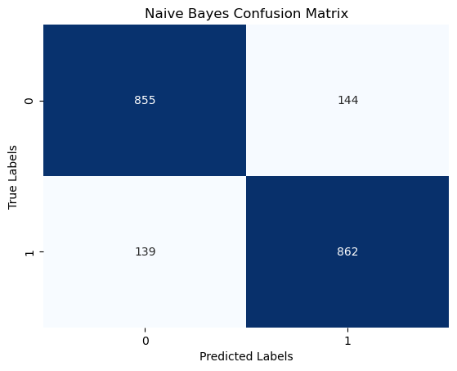
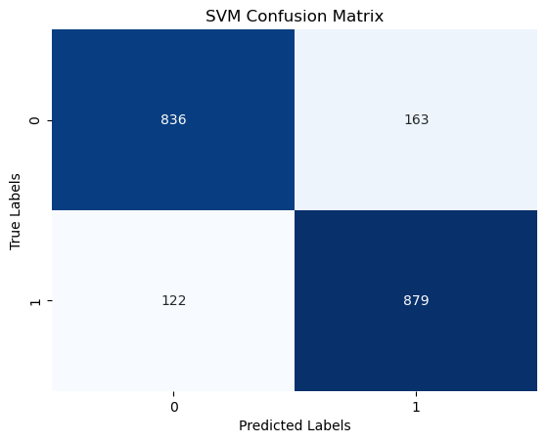
DATA VISUALIZATION BASED ON OUTPUT
For enhancing our analysis it is better and understandable if we provide clear results from SVM and Naive Bayes we can add some visulizations. These plots can interpreted the model performance and understand the distribution of sentiments for our prediction

Slide 14
CONCLUSION
Overall, the project demonstrated a thoughtful approach to sentiment analysis by not only applying and comparing traditional and advanced techniques but also by continuously seeking improvements through preprocessing, parameter tuning, and data augmentation.
The visualizations provided clear, actionable insights into each model's effectiveness, guiding future decisions for model development and application in real-world scenarios.

Slide 15
THANK YOU!

